Slide 1
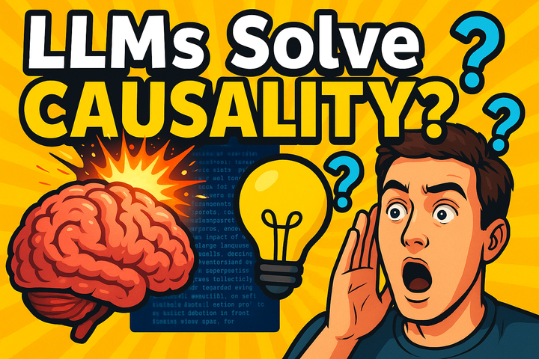

Slide 2
A New Frontier at
the Intersection of Causality and Large Language Models
Authors: Emre Kıcıman, Robert Ness, Amit Sharma, Chenhao Tan
Presenter: Selim Suleymanoglu Slides based on 1 2

Slide 3


?

Slide 4



Slide 5
This happens frequently in practice
Night lights cause myopia in young children? [Nature 1999]
“Children who sleep with a night light or other artificial light in their room until
the age of two have a higher incident of nearsightedness”
Missing a confounding factor: Parents with myopia!
Vitamin C and E reduces heart disease? [Lancet 2001]
Later failed RCT replications
Multiple confounds unaccounted: socioeconomic, behavioral, …
Source: http://bit.ly/refutedCausalClaims
Notes:
RCT=Randomised Controlled Trial

Slide 6
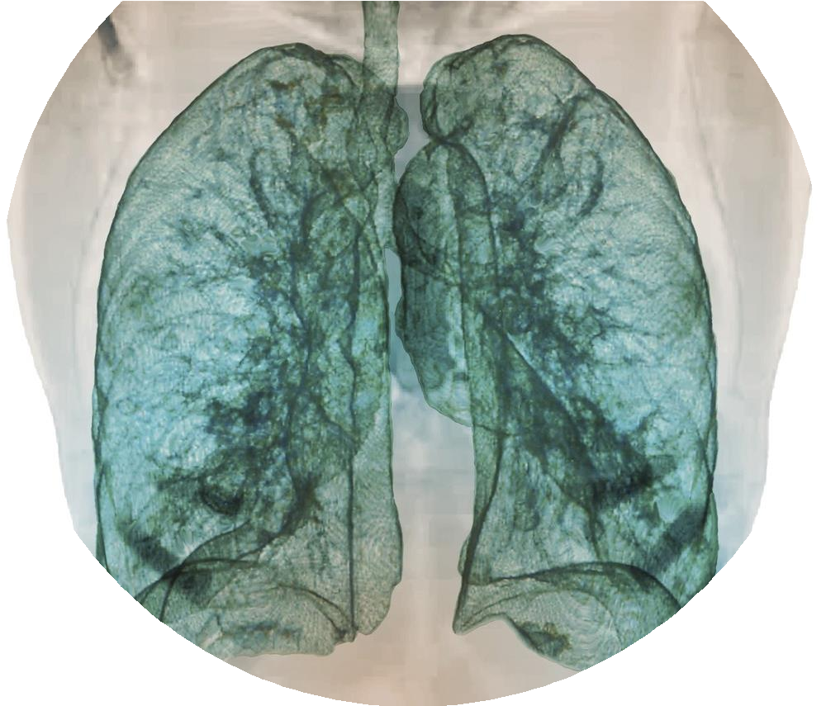
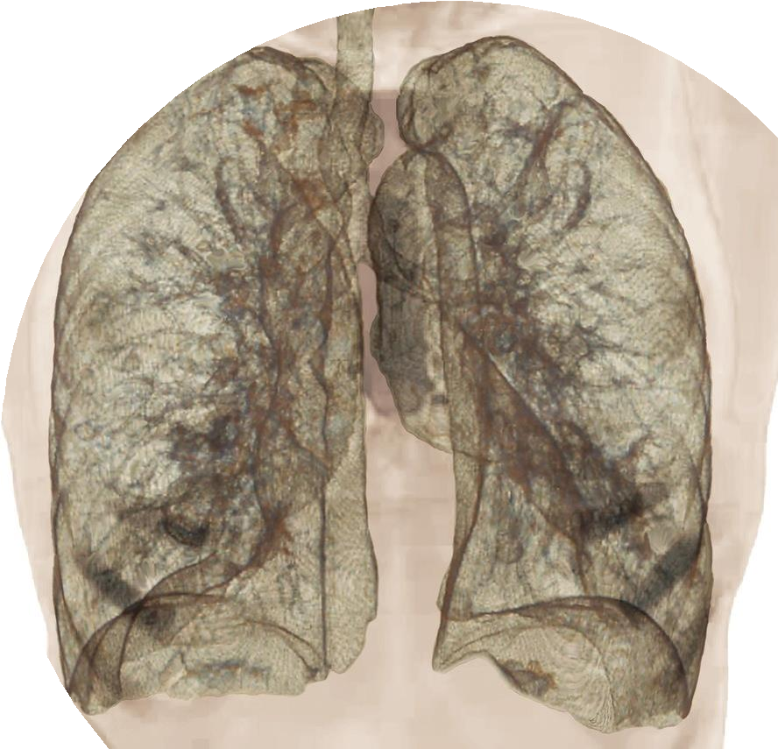
Similar problems continue today
100s of chest scan COVID classifiers found unreliable
e.g., sitting vs lying down; pediatric scans (children were not getting COVID at the same rate as adults early on)
[Roberts et al. NMI 2021, Wynants et al. BMJ 2020]
Notes:
Previous slide examples from decades ago, but issues persist today. E.g., early on during COVID many labs across the world started building CT scan classifiers to diagnose if the patient had COVID. Later on the cited analysed the reliability of these classifiers and found that none of them were actually reliable.

Slide 7
This talk: Large language model support to reduce burden on human domain expert
Two fundamental challenges for causal inference (require human input)
Assumptions for a casual argument (e.g., causal graph)
Reasoning over unstructured data (e.g., text)
LLMs are good in exactly these tasks that need human input:
-Results on causal graph recovery
-Results on counterfactual inference from text
-But LLMs have unpredictable errors
Future: How to combine LLM + principled causal methods?
-Big opportunity to accelerate causal analysis across scientific fields

Slide 8
Part I:
LLMs and causal relationships

Slide 9
Causal assumptions
Pairwise relationships
Given a pair of variables (A,B), decide whether A causes B or B causes A?
Full graph recovery
Given a set of variables infer a directed acyclic graph over them.
Infer which pairs of variables form an edge, and their direction.
B
A
A
B
A
B
C
D

Slide 10
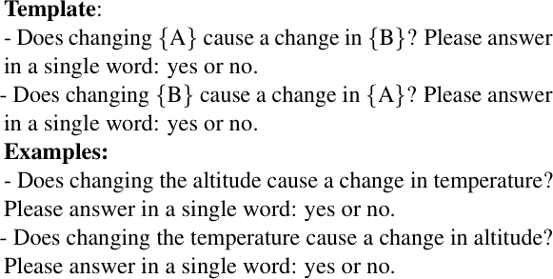
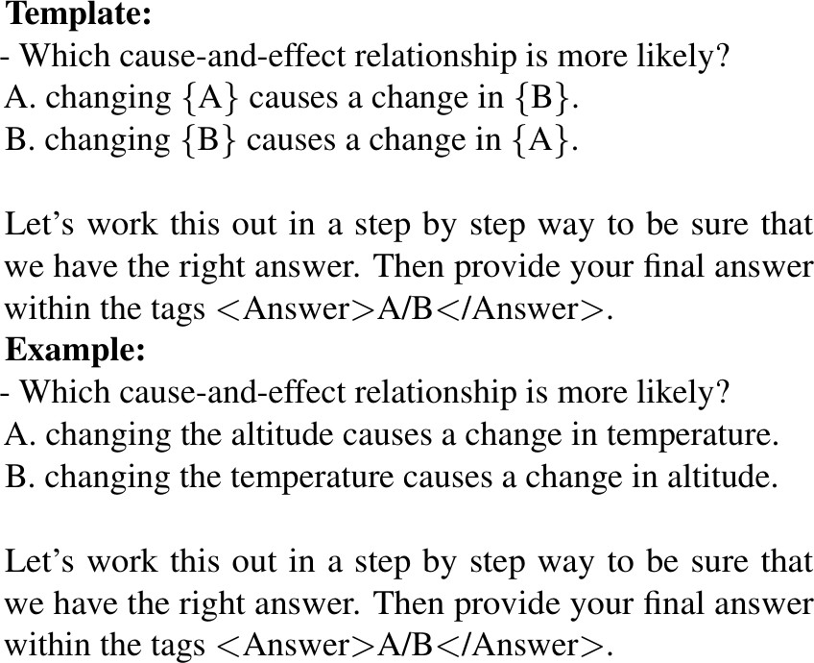
Applying LLMs to pairwise causal recovery
Method: For each pair, input below prompts to an LLM and record the output.
Two prompts per pair Single prompt

Slide 11
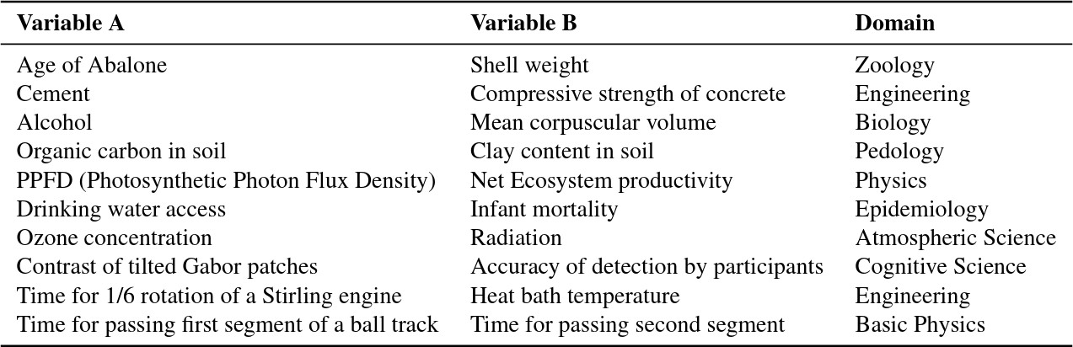
Tübingen Benchmark for Pairwise relationships
104 variable pairs spanning range of fields [Mooij et al. 2016]
Challenging task: Most discovery algorithms achieve 70-80% accuracy, Best in this benchmark is 83% [Mosaic, Wu & Fukumizu 2020].
Notes:
This benchmark is designed to test data-driven methods for causal discovery where you look at residual error in the underlying data to see the direction between A,B. We ask. Does dr

Slide 12
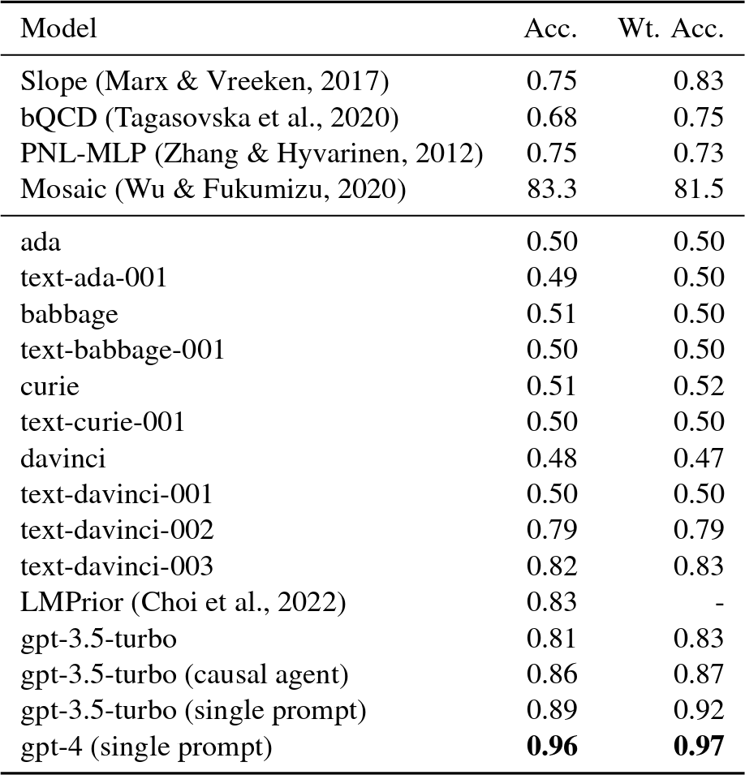
Results: LLMs recall 97% correctly
Data-driven causal discovery
Knowledge-based causal recovery is competitive with or much better than data-driven approaches
Notes:
LLMs do much better. This should not be taken as a direct comparison here because they are approaching these tasks in completely different ways. In particular LLMs primarily rely on the fact that this relationship is already known and has been written about somewhere on the internet and incorporated into the LLM’s training data. So it kind of knows the answer in a sense already. If we gathered data for some new relationship, something that had not been studied before, where we did not have a prior understanding of the relationship between these two variables I would expect the LLM not to be able to give an answer while the data driven analysis would still be able to look at the data and tell us something. But still, when we’re talking about what we’re asking the human domain expert to do when we are crafting a causal analysis, this is exactly the realm we are in. We’re asking the domain expert to bring their existing knowledge of what’s already known to help us structure the analysis. Now, what about those extra 3-4%? What are those errors?

Slide 13
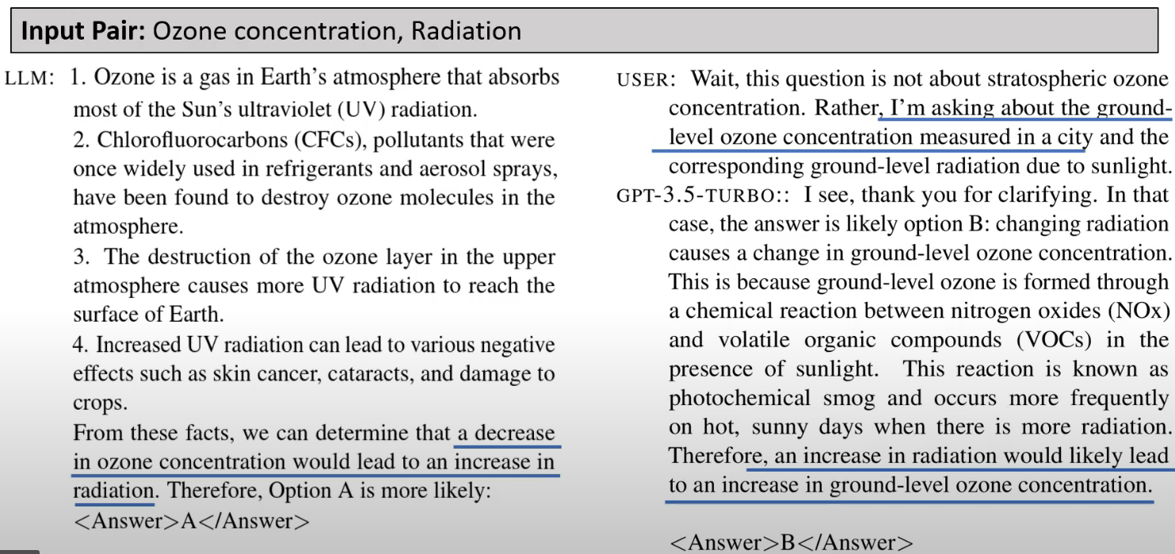
Errors include ambiguous features
Notes:
Some of there errors are ambiguous features where there’s some misunderstanding. Here we see one of the questions from the Tubingen benchmark, which focuses on the relationship between ozone concentration and radiation. The question is does ozone concentration cause radiation or radiation cause ozone? Tubingen benchmark says radiation causes ozone. LLM says no ozone causes radiation. It turns out it’s a misunderstanding on what we meant by ozone and radiation and what the LLM understood. One part of our prompt asks the LLM to describe its reasoning and it says a little more about the setting. It makes it very clear that it’s talking about ozone in the stratosphere and UV radiation. We can actually correct it and say that we’re asking about ground level ozone concentration and radon. It turns out yes, that radon is the case of ozone at ground level. We have an additional probing of this and are trying to find new strategies to more generically identify these types of scenarios. And one promising approach does seem to be simply asking for every pair of features. Is there any ambiguity in the interpretation of these feature names that would cause you to change your opinion? Then it’ll give that answer if it exists. This is a real, pretty common, occurrence that if there’s some ambiguity, especially if you’re just taking column names from a spreadsheet for example.

Slide 14
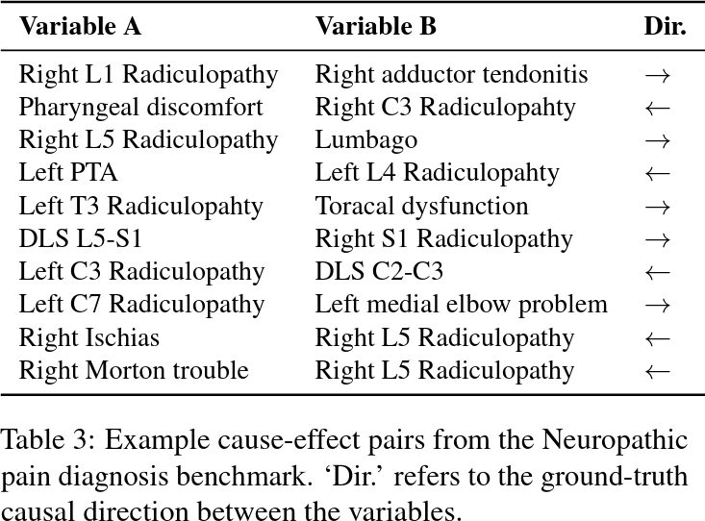
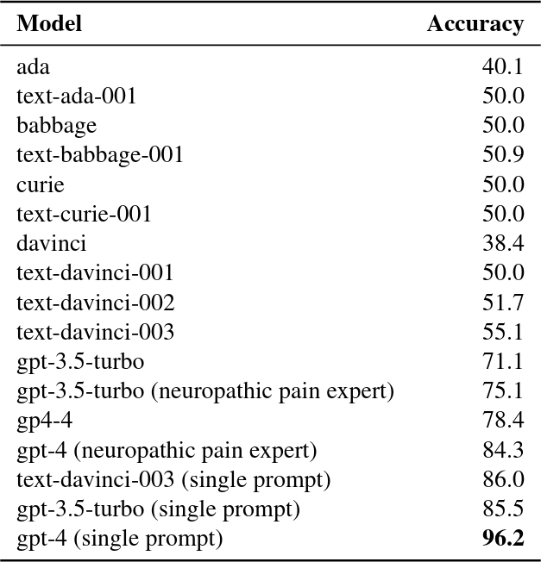
Similar results on a neuropathic pain dataset
221 nodes & 475 edges about neuropathic pain diagnosis [Tu et al. 2019]. Use all edges as pairs.
Notes:
They continue these types of experiments across more complicated data sets. While Tubingen benchmark gives pairwise relationships, they also looked at a neuropathic pain dataset that had a larger graph of causal relationships where we could ask about

Slide 15


Construct Validity: Is Benchmark Memorized?
You are an AI assistant that has read many sources of text from the internet. I am looking at text from the dataset, published by as . Here is the README for the dataset: I am going to list some sample rows of data, and I want you to complete each row as best as possible. I am testing your memory.
SYSTEM
 | Cells | Rows
GPT-3.5 | 58.9% | 19.8%
GPT-4 | 61% | 25%
pair0005 Age
Yes, Tübingen dataset clearly in the training dataset.
USER
pair0005 Age Length Abalone ->
GPT

Slide 16
Construct Validity: What are we Measuring?
Let us model knowledge-based discovery as:
𝑃 𝑌 𝐷 𝑃 𝐷
Likelihood that knowledge can be
transformed to answer question Y
Likelihood that knowledge D
is known by LLM
With memorized benchmark data, we are not measuring 𝑃(𝐷)
We are measuring: how LLM can process and transform 𝐷 into the necessary causal relationship 𝑌

Slide 17
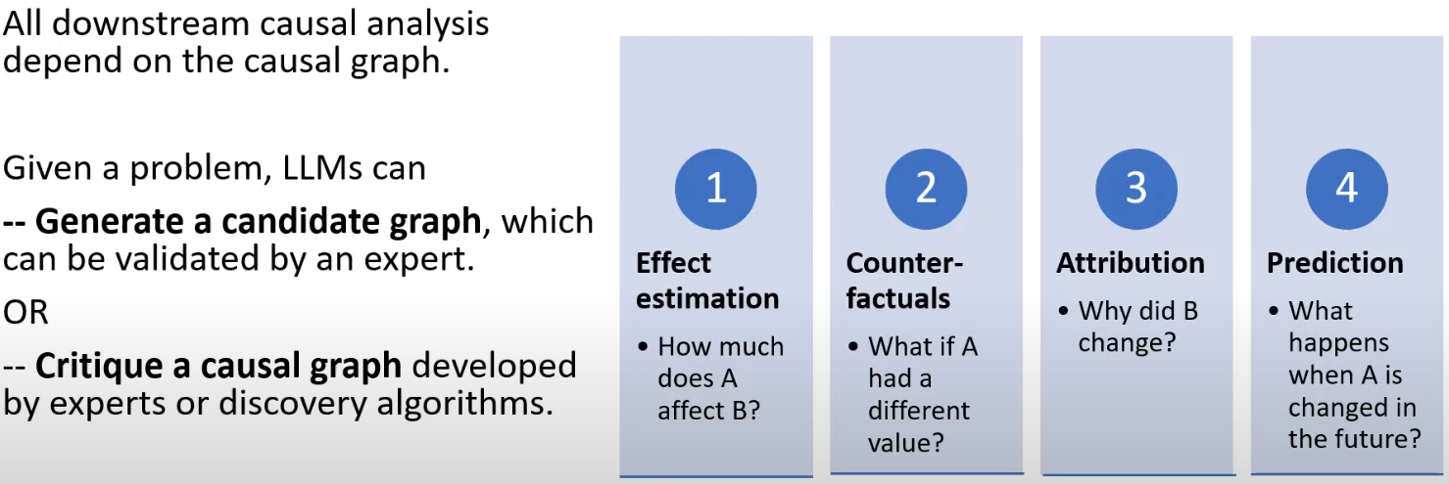
Implications for causality in practice: A useful tool to accelerate causal studies

Slide 18
How else might LLMs help?
LLMs can help in many tasks that were understood to be impossible for algorithms:
Improving a causal study (e.g., suggesting missed confounders)
Developing a causal study (e.g., suggesting an instrumental variable)
Validating a casual study (e.g., suggesting a negative control)

Slide 19



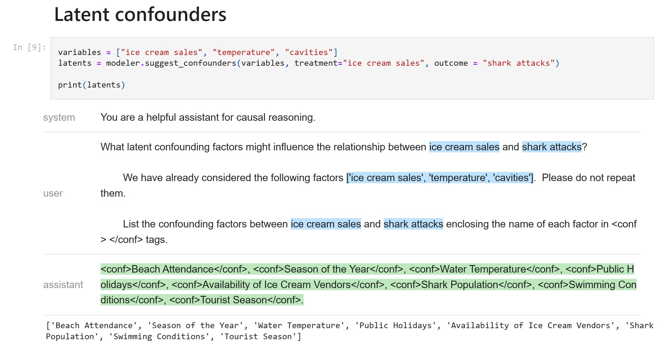
Adding to the Open Source Ecosystem for Causality
PyWhy-LLM
Python library for using LLMs in causal analysis process
Integrates with PyWhy libraries (DoWhy, EconML, …)
Work-in-progress
https://pywhy.org/ https://github.com/py-why/pywhy-llm/

Slide 20
PART II:
Causal reasoning over text
(LLMs and event or actual causality)

Slide 21





Event/Actual Causality and Causal Judgments
Type (General) Causality
Bob has lung cancer and smokes.
Did Bob’s smoking cause his cancer?
Inference over a (sub)population
A customer saw a newspaper ad and bought toys. What would have happened if they hadn’t seen the ad?
Actual Causality
A doctor washes their hands before surgery. What would have happened if the Dr hadn’t washed their hands?
Inference over a single event

Slide 22
Causal context is hard to formalize
Causal frame: Factors relevant to causal question
Necessary causality: Did cause need to happen for outcome to occur?
Sufficient causality: Is cause alone enough for outcome to occur?
Normality: Do events line up statistical/social/... norms?
Other human factors: bias towards action, intention, epistemic, …

Slide 23
Building block: Counterfactual reasoning
Key element of actual causality
E.g., simulating alternate outcomes
Also useful for decision-making, planning…

Slide 24
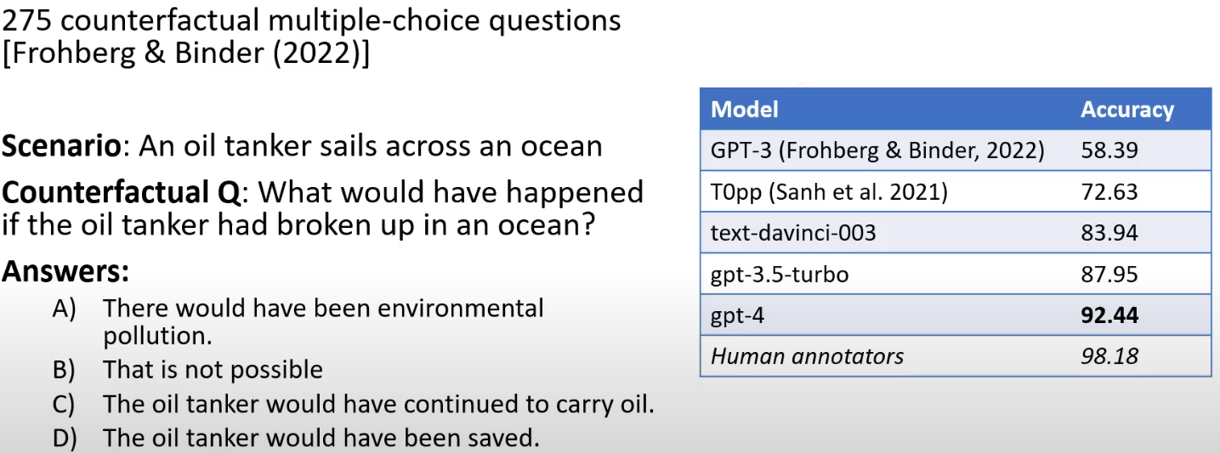
CRASS Counterfactual reasoning benchmark

Slide 25
Necessary and sufficient causes
Necessary causality:
If an event 𝐶 does not occur, then the outcome event, 𝐸, will not occur.
Sufficient causality:
If an event 𝐶 occurs then the outcome event, 𝐸, will occur.
Robust sufficient causality:
… even if other contributing factors did not occur.
Sufficiency is harder, because we have to determine causal frame

Slide 26
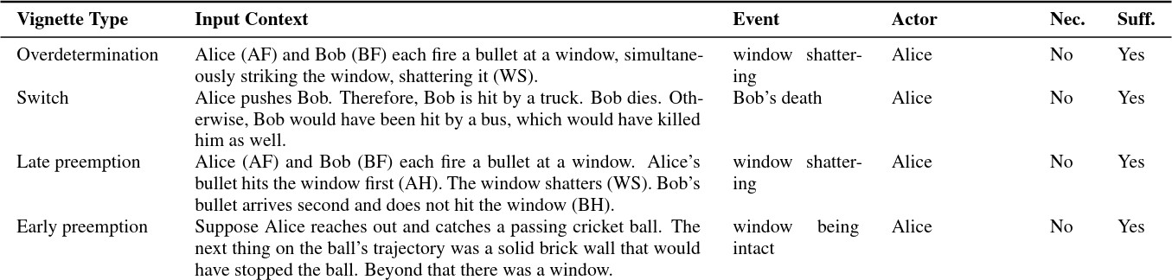
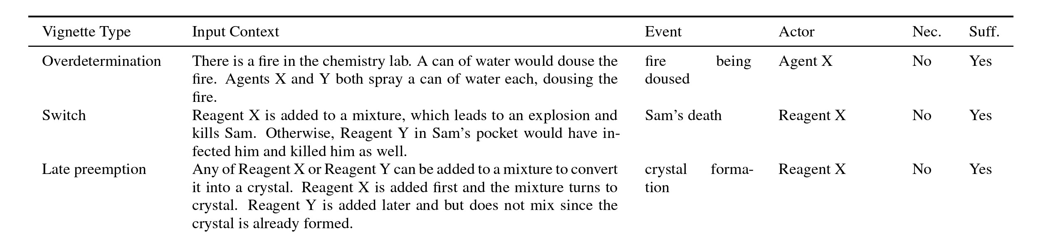
Evaluation Vignettes
Kueffner (2021)
Novel vignettes
Notes:
Published vs novel (could not have been previously seen by the LLM in its training data)

Slide 27
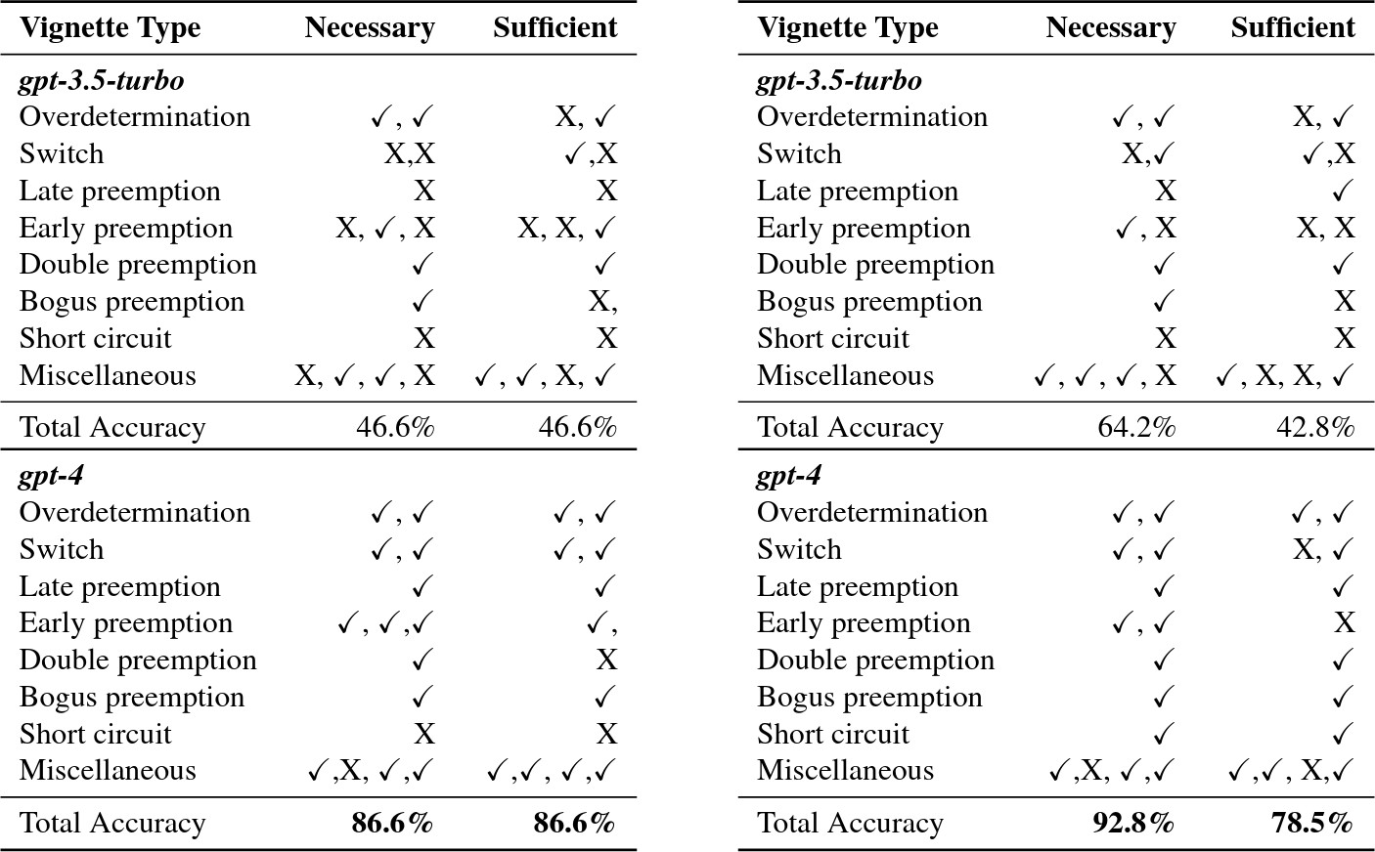
Necessary and Sufficient - Results
GPT-3.5
GPT-4

Slide 28
Takeaways on text-based reasoning
Substantial improvements in LLm’s counterfactual reasoning ability
GPT-4: 92.44% accuracy (only 6% below human baseline)
GPT-4 understands scenarios, identifies necessity and sufficiency
Not possible before
See paper for additional experiments
TL;DR: 70% accuracy with GPT-4

Slide 29
Discussion: A new frontier for causality

Slide 30
What is new with causality now
LLMs provide…
Domain knowledge only available via human experts before
Provide when explicitly asked
Also implicitly, e.g., in background knowledge for actual causality vignettes.
New capability to extract key primitives of text-based reasoning
(necessity, sufficiency, normality, etc.)
Possibility of system to analyze actual causality for practical scenarios

Slide 31
What is not changing with causality
Need for rigorous, well-documented, and verifiable analyses
Especially for high-risk and high-value tasks
Must ensure correctness for decision making

Slide 32

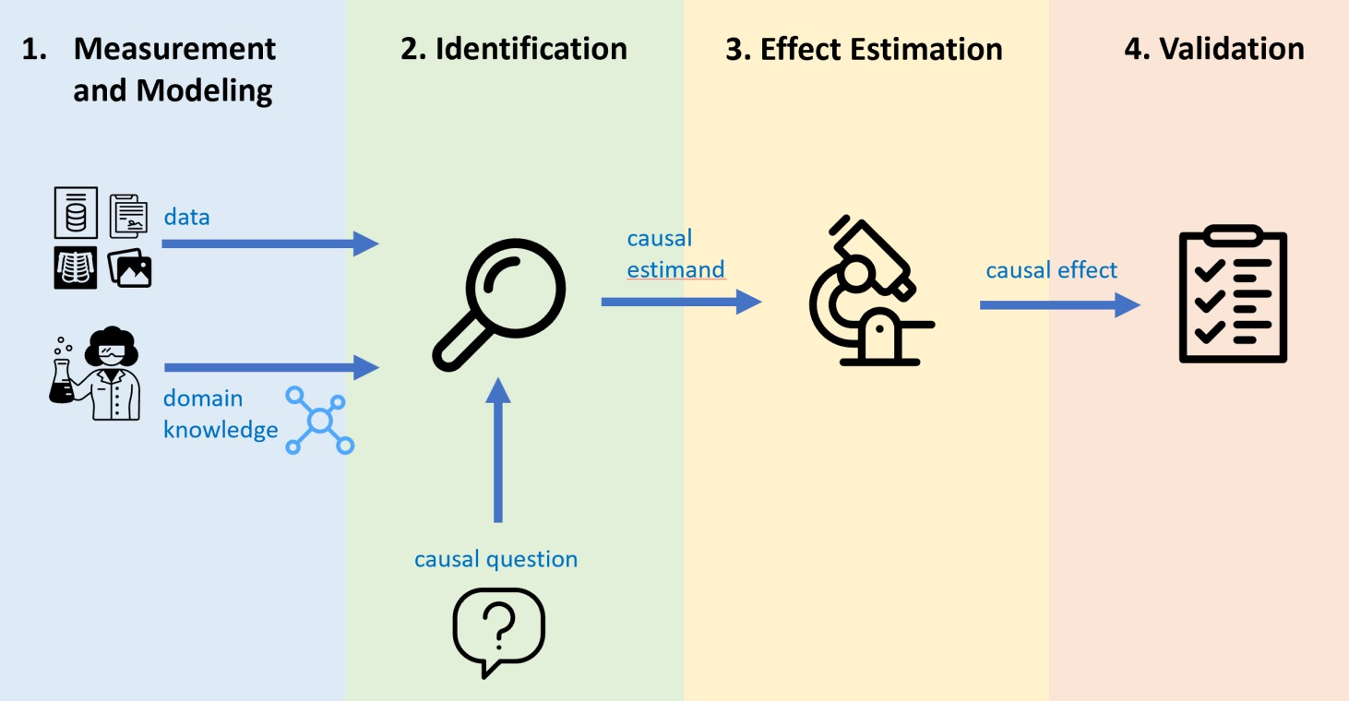
Implications for Practitioners
Augmenting human expertise with LLMs
Assisting in graph creation, validation, and robustness checks
Case study: LLM-assisted identification of negative controls
LLMs can enable end-to- end causal tools
Case study: asking LLM to generate DoWhy and EconML analysis code
LLM-based discovery
LLM-assisted
validation
DoWhy/EconML code generation
LLM as a fluid conversational interface
Fluid user-LLM conversation

Slide 33


Conclusion: A New Frontier for Causality
Human domain knowledge critical for causal analysis
LLMs mimic this capability
Building causal assumptions and arguments, counterfactual inference, and
systematization of necessity, sufficiency, …
Implications for practice:
Reduce burden on human domain expert
New research questions:
Combining data-driven and text-based analysis?
https://pywhy.org/ https://arxiv.org/abs/2305.00050

